Slide 1
CZ4042 Neural Network & Deep Learning
Assignment 02
Cheng Mun Chew
Tang Han Kang
Tang Zhi Tern
Notes:
Hello everybody
Welcome to our video presentation for CZ4042, Neural Network and Deep Learning, Assignment 02.
This presentation includes Cheng Mun Chew, Tang Han Kang, and myself, Tang Zhi Tern.

Slide 2
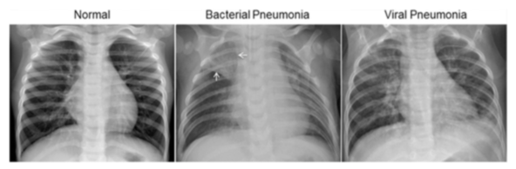
Diagnosing Pneumonia
Dataset
Notes:
In this assignment, we will train a model to diagnose Pneumonia using X-ray images from Kaggle.
diagnosing pneumonia from chest X-ray images is a difficult task for even experienced radiologists. This is because the symptoms of pneumonia in X-ray images are often unclear, confused with other diseases and contain abnormalities. We will use AI to aid making these inconsistent and sometimes subjective decisions.
In this dataset, there are about 5800 images, classified as Normal, Bacterial, or Viral.
However, In our experiment, we will do binary classification. We will only predict if Pneumonia is present or not in an image.

Slide 3
Experiments
Data Preprocessing to improve accuracy
Improving on VGG16
Improving on ResNet50
Notes:
In this assignment, we will be conducting 3 experiments to try and achieve good results
Using Data Preprocessing, and modifying two well known models, VGG16 and ResNet50

Slide 4
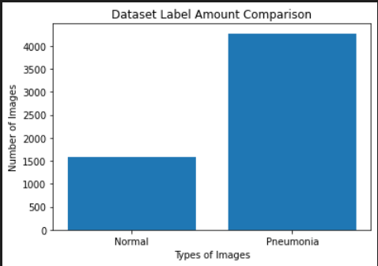
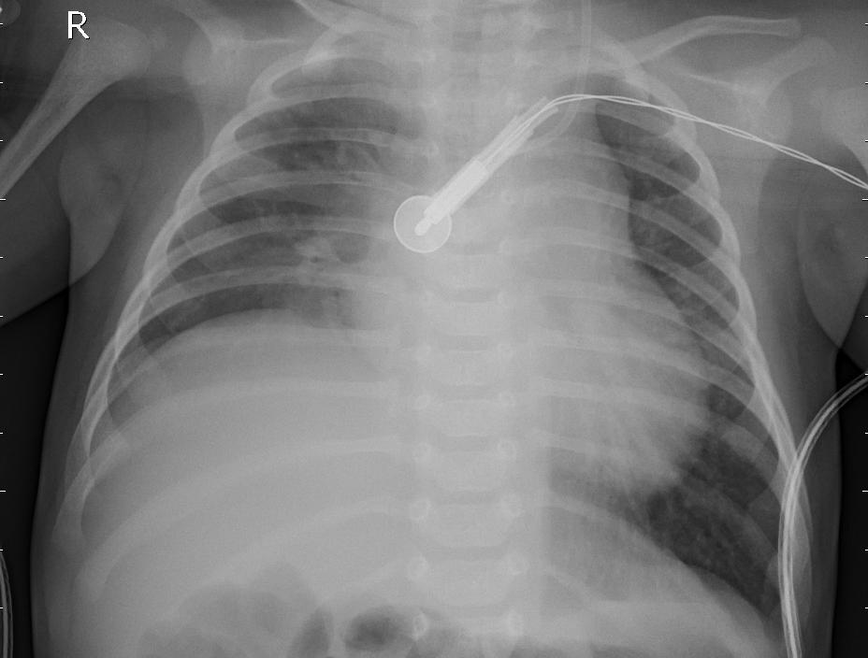
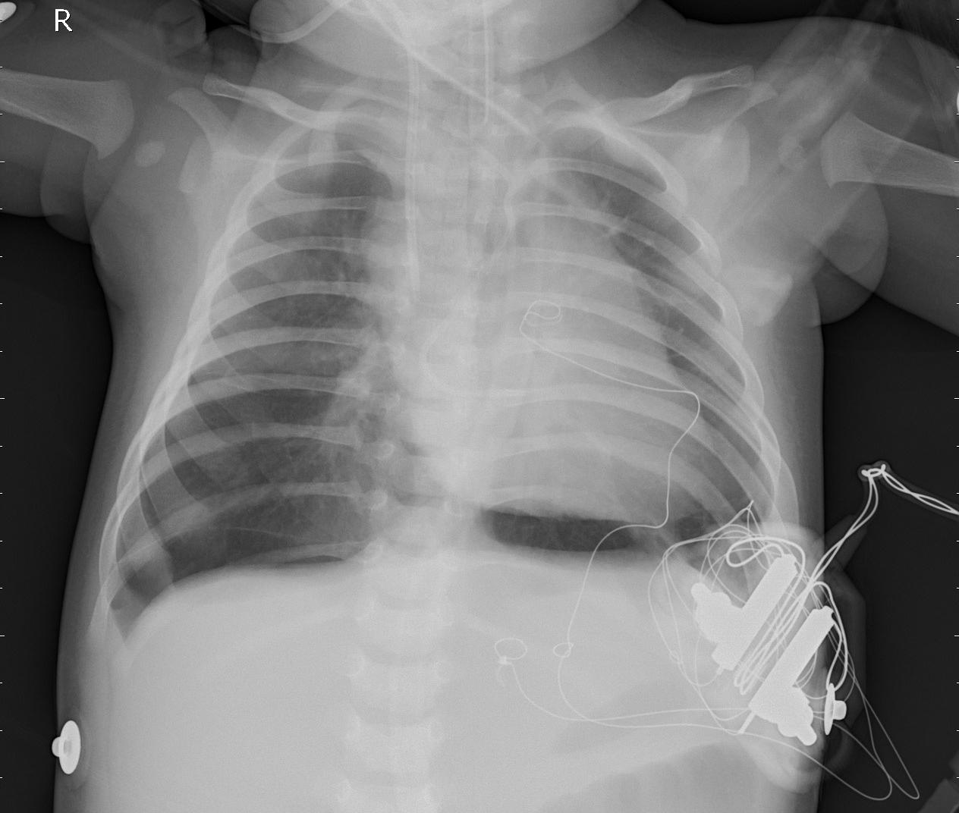
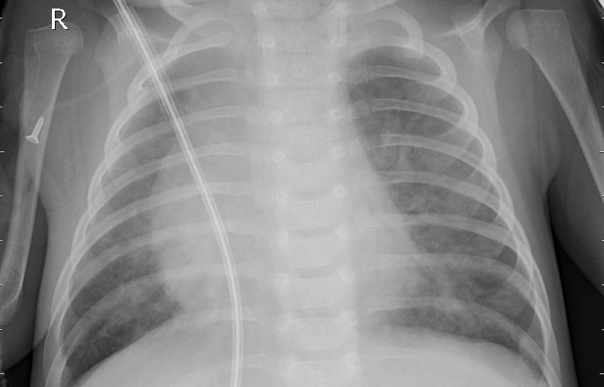
Dataset Analysis
Data imbalance
Data Noise
Notes:
We first analysed the dataset and noticed two main problems.
Firstly, there is a imbalance in this dataset, having significantly more pneumonia images than normal ones.
Secondly, there are some images which contains medical devices, which may be deemed as noise. However, we choose to ignore these as we foresee this to be a natural occurrence in future images.

Slide 5
Mitigating Dataset Imbalance
1583 Normal 4273 Pneumonia | A Class Weights | B Augment till 50/50 | C Augment Half of Normal
Val Loss | 0.539438 | 0.309689 | 0.434598
Val Accuracy | 0.740607 | 0.849648 | 0.791549
Val Precision | 0.892862 | 0.850699 | 0.768821
Val Recall | 0.777865 | 0.882657 | 0.981380
Test Loss | 0.655411 | 0.453824 | 0.231218
Test Accuracy | 0.844710 | 0.790102 | 0.909556
Test Precision | 0.978916 | 0.769811 | 0.929952
Test Recall | 0.794621 | 0.997555 | 0.941320
Notes:
To mitigate Dataset imbalance, we compared the results of using Class Weights versus Data Augmentation.
*Click*
Looking at the validation metrics, we can see that scenario B gives the minimal loss, highest accuracy, and relatively balanced precision recall.
*Click*
However, when it comes to evaluating against the test dataset, it gives the lowest accuracy. That, along with its significant difference in precision and recall values, may indicate overfitting.
Following the test results, we will use scenario C for for its lowest loss, highest accuracy, and most balanced precision recall values.

Slide 6
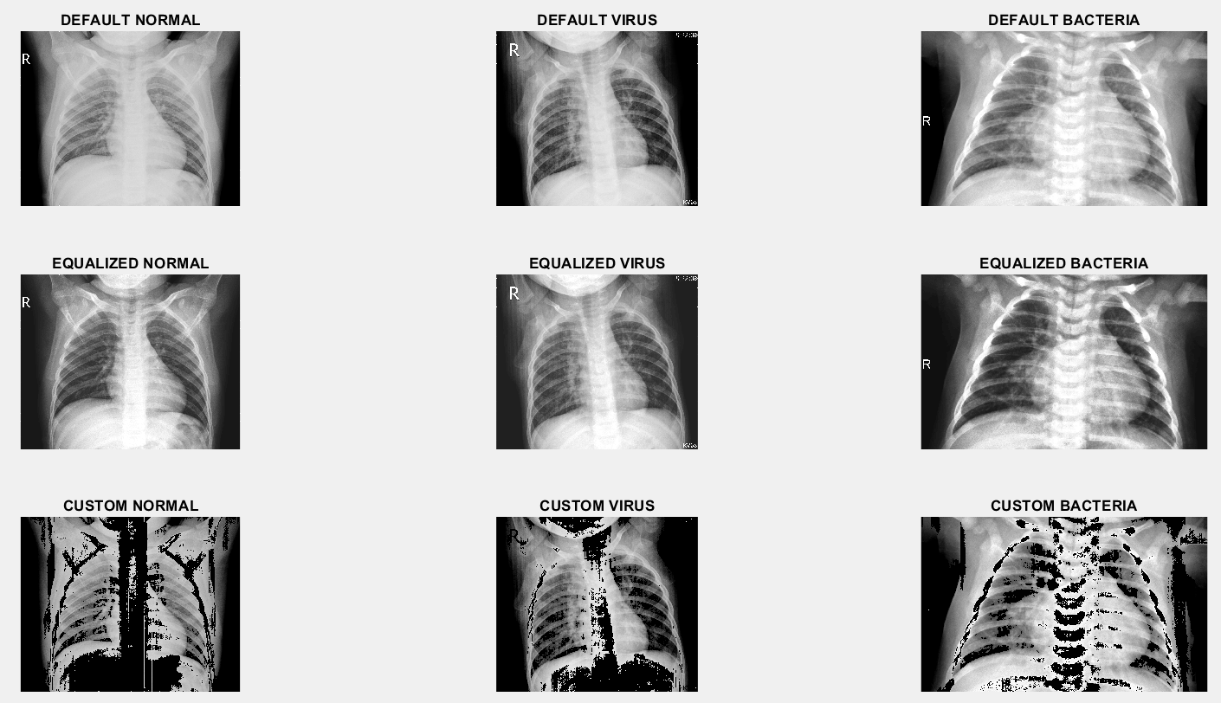
Data Preprocessing
Notes:
Before we jumped into adjusting a model, we wanted to find out if we could make an impact purely through Data Processing.
Here, we attempt Contrast Stretching through Histogram Equalization, and a custom algorithm.

Slide 7
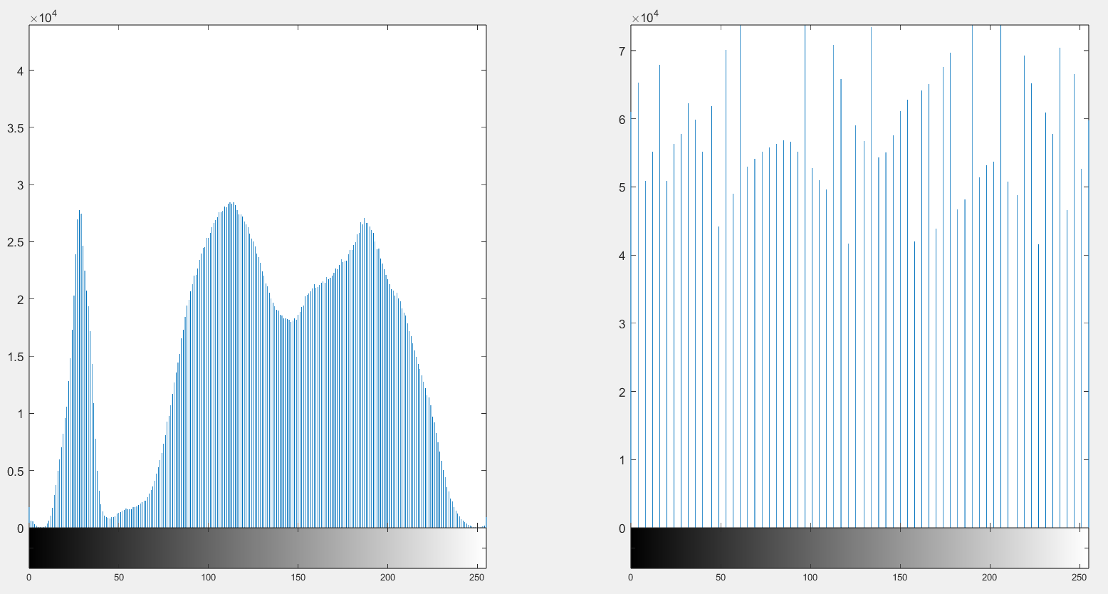
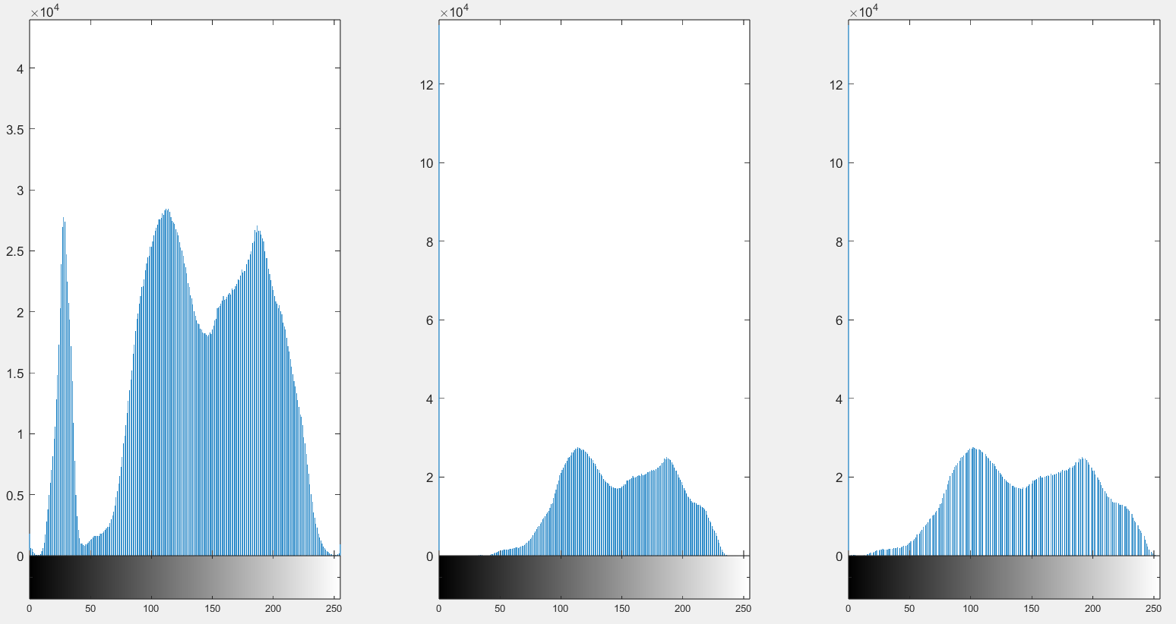
Data Preprocessing
Custom Algorithm
Histogram Equalization
Notes:
Histogram Equalization attempts to spread high frequency pixels to give a linear trend to the cumulative probability function associated to the image. It is simple and efficient.
*Clicks*
The custom algorithm removes the lowest 30% and highest 15% of pixels, by setting them to 0. Next, it stretches the histogram bins while maintaining the general shape of the histogram bins.

Slide 8
Data Preprocessing
 | A Default Dataset | B Equalized Dataset | C Custom Dataset
Test Loss
Test Accuracy
Test Precision
Test Recall

Slide 9
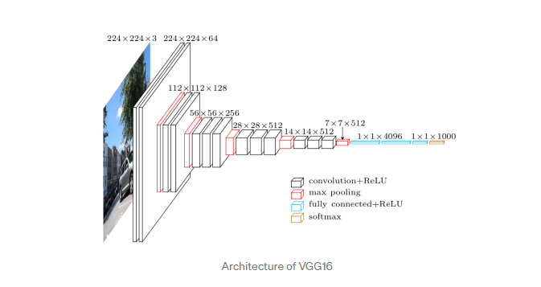
VGG16
CNN architecture model that won Imagenet ILSVRC 2014
13 Convolutional, 5 MaxPooling, 3 Dense layers
Very small 3x3 receptive filters
‘Same’ padding
MaxPooling with 2x2 filters
Source:https://towardsdatascience.com/step-by-step-vgg16-implementation-in-keras-for-beginners-a833c686ae6c
Notes:
VGG16 is a CNN architecture model that won the 2014 ImageNet Large Scale Visual Recognition Challenge (ILSVRC). The model consists of 13 convolutional layers, 5 Maxpooling and 3 dense layers, however only 16 of them have weights therefore the term vgg16. A unique part of vgg16 is that for each convolutional layers, it uses 3x3 receptive filters with stride =1. This allows for the conv layer to capture most information about the image across all the channels while keeping the size of the convolutions layers consistent with the size of the image at the same time. The padding is kept ‘same’ throughout and maxpooling has a 2x2 filter with stride=2.

Slide 10
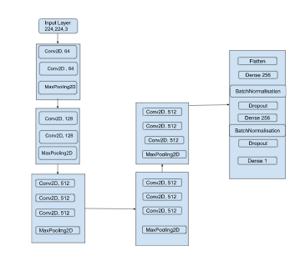
Modified VGG16
Imported the imagenet weights
224 x 224 x 3 input layer
Flatten layer
Dense layers with 256 hidden neurons
L2 Weight regularizers
BatchNormalization layer
Dropout layer with rate 0.4
Notes:
We modified the VGG16 architecture to do transfer learning on our dataset. Our modified VGG16 consists of an input layer that takes in an input image shape of 224 by 224 by 3. We appended a flatten layer to convert the output from the pooling layer so that we can feed it into our fully connected layers. We added 2 Dense layers with 256 hidden neurons in between and with l2 regularizers to decay weights. Batchnormalization layers were added to reduce overfitting and speed up the training process. Similarly, Dropout layers with a rate of 0.4 were also added to reduce overfitting. Lastly we have a Dense output layer with sigmoid activation function.

Slide 11
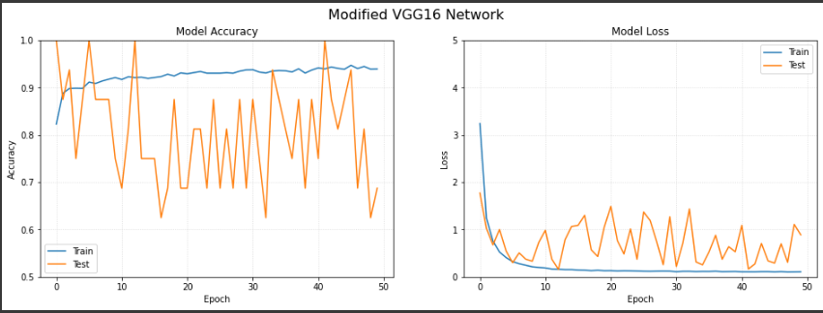
Modified VGG16 training
Training parameters:
Binary cross entropy loss functions
RMSprop optimizer (learning rate=1e-2)
Batch size = 64
Epochs = 50
Google Collab GPU runtime session
~ 120 minutes training time
Notes:
The hyperparameters that modified VGG16 model used to train includes firstly, binary cross entropy loss function because there are only 2 classes to predict, secondly, RMSProp optimizer is chosen as it accelerates learning process of the weights. Batch size is 64, epochs we use is 50. The model was trained on the 5216 training data images and 16 validation images on Google Collab GPU runtime session. The model took an estimated 2 hours to train. As shown in the graph, the training accuracy was generally higher than the validation accuracy throughout the training which meant that there is overfitting. Thus, more fine-tuning could have been done such as more dropout, heavier weight decay and smaller optimizer learning rate.

Slide 12
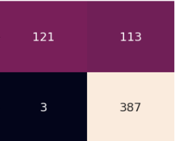
Evaluation
Test data set with 634 test samples
Achieved ~81% accuracy
For ‘Normal’ test samples:
Precision = 0.98
Recall = 0.52
F1-Score = 0.68
For ‘Pneumonia’ test samples:
Precision = 0.77
Recall = 0.99
F1-Score = 0.87
Notes:
After training the model, the model is used to make predictions of the test dataset which consists of 624 test samples. The model achieved an estimated 81% accuracy on the test data. We measured the model’s performance on a confusion matrix, and from there we can infer the precision, recall and f1 score of the model’s predictions on each class label as shown. From the results, we notice that the recall for Normal test samples were low at 0.52. This means that there is a high false positives which could be due to the imbalance data labels. Hence, more could have been done to minimise the problem of data imbalance aside from class weights and data augmentation.
This includes oversampling the lesser data and further fine-tuning the model.
Now i will let han kang to explain the Resnet50 model implementation.

Slide 14
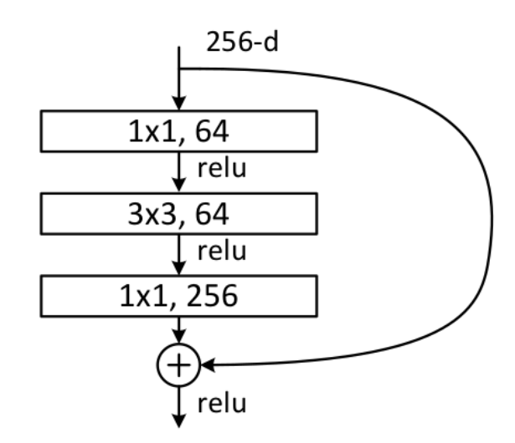

ResNet50
Introduction
Convolutional neural network
50 layers deep: 48 Convolution layers, 1 MaxPool and 1 Average Pool
Addresses the issue of vanishing/exploding gradients using shortcut connections
Able to train extremely deep neural networks, while maintaining performance
Residual Blocks of ResNet50
https://iq.opengenus.org/resnet50-architecture/
Notes:
Another model we employed is ResNet50.
ResNet50 is a convolutional neural network in the family of residual networks.
It is 50 layers deep, with 48 convolution layers, 1 max pooling layer and 1 average pooling layer.
The 48 convolution layers are made up of residual blocks as shown in this image.
The advantages ResNet have over conventional CNNs is the presence of shortcut connections. This aims to address the issue of vanishing or exploding gradient. Which is a problem many models faced when increasing the number of layers.
Hence resent50 models can capitalise on its depth to learn more complex patterns while at the same time maintaining performance

Slide 15
ResNet50
Code Implementation
Base model: tensorflow ResNet50 trained on imagenet dataset
Remove the top layers while freezing the remaining layers
Added a dropout layer and a sigmoid activated output neuron
Train model and save weights
Fine-tuning: unfreeze a user specified number of layers and retrain the model
Make predictions on test data set
Notes:
As for the code implementation,
We used the tensorflow resnet50 model as our base model. The model’s weights were trained on the extensive imagenet dataset.
Given the fact that our dataset is relatively small, we used transfer learning to prevent the model from overfitting, which is likely to happen if we were to train the model from scratch
For our case, we swap the top layers of the resnet50 model with our classification problem specific layers (a dropout layer and a sigmoid activated output neuron, for binary classification.)
Next we train the model on our dataset and save the weights. The purpose of saving the weights will be explained in the next slide.
Next we fine tune the model unfreezing a certain number of layers (specified by the user) and retrain the model
Lastly, to test the performance, we used our model to make predictions on unseen test data set

Slide 16
ResNet50
More about Fine-Tuning
Earlier layers identify more general features
Later layers identify task specific features
Number of top layers to unfreeze is a tunable hyperparameter
For a blackbox method, only way is to do testing for hyperparameter tuning
Total number of layers = 176, tested with 110 to 140 freezed layers
Optimal number of frozen layers are determined through comparison of minimum loss
Notes:
Going abit more indepth about fine tuning.
Generally speaking, earlier layers of trained models can identify more general features. Such as edge detection and shape detection.
Whereas later layers are more for identifying task specific features.
However how many layers to unfreeze (or how many layers are used specifically for the task) is unknown to us, since deep learning models are black boxes.
Therefore we can only rely on empirical data to determine how many layers to unfreeze.
The base model has a total of 176 layers, and we trained the model after freezing 110 layers only, up to 140 frozen layers, in incrementations of 10. We need to reset the model to the original weights before hyperparameter tuning, hence the model weights were saved.
The optimal number of frozen layers is then determined by comparing the minimum losses for each level of frozen layers.

Slide 17
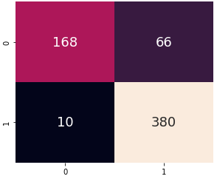
ResNet50
Model’s Performance
Making predictions on 624 unseen images
Model manage to hit an accuracy of 88%
High false positive proportion is alarming, making it unusable in reality
Actual values
Predicted values
Notes:
Now, to analyse the model’s performance.
The final model, trained with 120 frozen layers is used to make predictions on 624 unseen images
And the model was able to hit an accuracy of 88%
However, what we can see from the confusion matrix below is the high false positive proportion. This is undesirable in the real world setting, as many patients will be given a false diagnosis. Which can lead to wastage of medical resources.

Slide 18
Conclusion
Further improvements
Generative Adversarial Networks to address data imbalance
Include bounding boxes on labelled data
Future application
Adapt model to identify other lung diseases
Covid19
Early stages of cancer
Notes:
To conclude, these are some further improvements we would have love to make for our project :
Firstly, using Generative Adversarial Networks to address class imbalance in the provided data.
Secondly, include bounding boxes on labelled data. To help model focus on the correct abnormality regions. This improvement can only be made achievable through consultation with medically trained professionals.
As for further application of our solution, we can adapt the model to identify other lung diseases such as covid19 and early stages of cancer.

